Slide 1
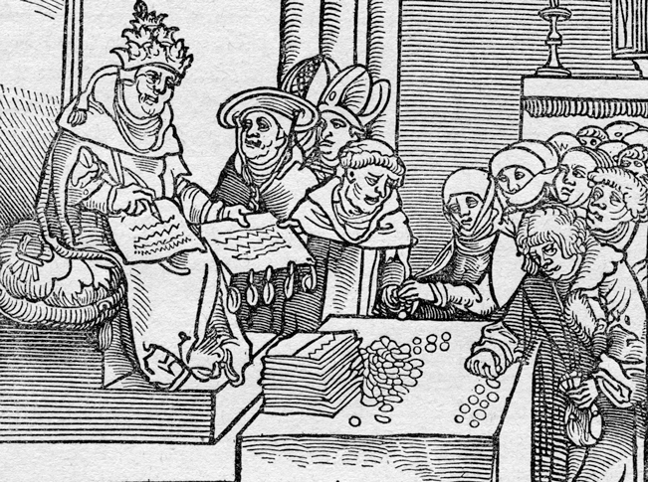
The Renaissance and Reformation (1300–1650)
Lesson 3 The Protestant Reformation

Slide 2
The Renaissance and Reformation (1300–1650)
Topic 4 Lesson 3 The Protestant Reformation
Learning Objectives
Summarize the factors that encouraged the Protestant Reformation.
Explain the impact of the printing press on the Reformation.
Analyze Martin Luther's role in shaping the Protestant Reformation.
Explain the teachings and impact of John Calvin.

Slide 3
Causes of the Reformation
Abuses Within the Church
The Church was getting into more political affairs
Popes fought wars, led lavish lives, and competed for power
They became patrons of arts. To finance they raised the price of baptism, marriages, and promoted the sale of indulgences
Christians protest the practice, want to bring back the simplicity
They stress Bible study and reject Church pomp and ceremony
Early Reformers
English John Wycliffe – translate the Bible into English
Czech John Hus – rejected church teachings, burned at the stake

Slide 4
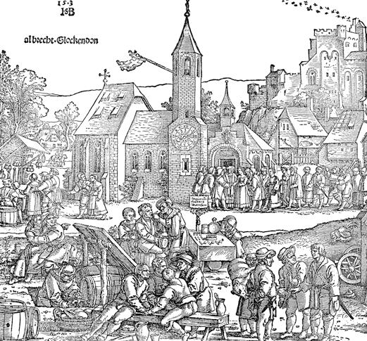
Causes of the Reformation
During the 1500s, European villages were busy places, with markets, artisan shops, and homes. The church was the center of village life.

Slide 5
Martin Luther's Protests Bring Change
95 Theses Challenge the Church
A German priest is selling indulgences to help rebuild St. Peter’s Cathedral. In response Martin nails 95 theses or arguments to the door saying why it was wrong.
A Firestorm Begins
Luther’s theses spread throughout Europe
Luther is excommunicated in 1521 by Pope Leo X and declared an outlaw by Charles V. However friends hide him from authorities
Luther’s Teachings
Salvation could be achieved through faith alone
Luther declared the Bible was the sole source of religious truth
Luther rejected the idea that the priests and Church hierarchy had special powers. Luther translated the Bible for the people
He rejects 5 out of 7 sacraments b/c the Bible doesn’t mention them, simplified Mass, emphasized sermons, allowed priests to marry, banned indulgences, confession, and pilgrimages

Slide 6
Martin Luther's Protests Bring Change
Luther’s Reforms Gain Support
The printing press spread Luther’s writings throughout Germany
Protestant is going to be used for the first time
Luther’s ideas are going to gain support as the answer to the corruption of the Catholic Church
German princes are going to support b/c it’s a way to revolt against the throne, the Church, and it’s patriotic
The Peasants’ Revolt
It happens in 1524. Luther does not support it and the German nobles ruthlessly end it, killing 100,000 people and leaving thousands more homeless
The Peace of Augsburg
Signed in 1555 Charles V and the German princes agree to allow the princes to decide to follow Lutherism or Catholicism. The north follow Luther, the south the Catholic Church

Slide 7
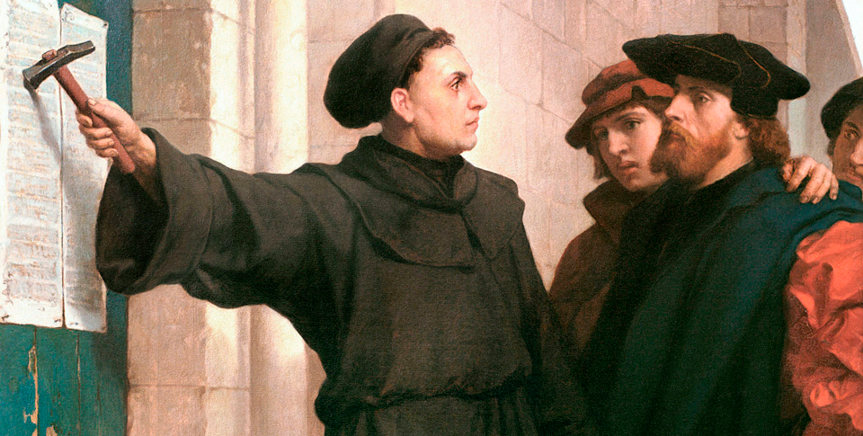
Martin Luther's Protests Bring Change
Martin Luther nails his 95 Theses to the church door in Wittenberg. The theses also contained an invitation to church leaders to debate Luther on the issues raised by his theses. The invitation was ignored.

Slide 8
John Calvin Challenges the Church
Calvin's Teachings
Born in France, he sets up the groundwork to set up a Protestant church. He is similar to Luther but not exact
Calvin believes in predestination, that man is sinful by nature. Calvinists tried to live like saints b/c saints were saved by God
Calvin's Geneva
In 1541 Geneva asks Calvin to rule so he sets up a theocracy
Calvinists stressed hard work, discipline, thrift, honesty, and morality. Citizens faced fines or worse for fighting, swearing, laughing in church or dancing.
Calvinist Ideas Spread
Late 1500’s Calvinism takes root in Germany, France, the Netherlands, England, and Scotland
In Germany Catholics and Lutherans opposed Calvinists
Calvinists in the Netherlands organize the Dutch Reform Church

Slide 9
John Calvin Challenges the Church
Calvinist Ideas Spread
In Scotland a Calvinist preacher named John Knox lead a rebellion and overthrow the Catholic Queen and establish the Scottish Presbyterian Church

Slide 10
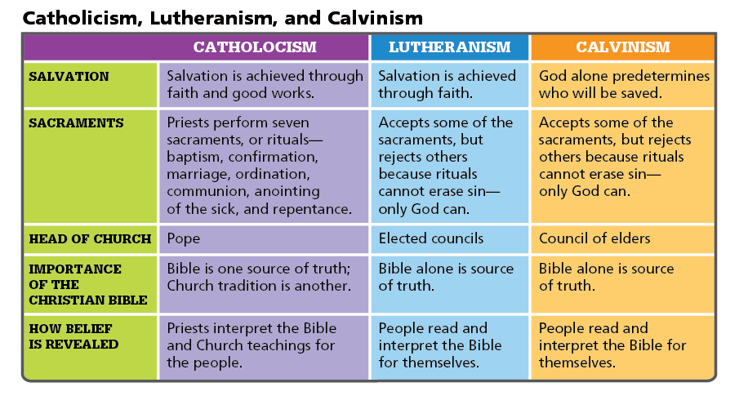
John Calvin Challenges the Church
Analyze Charts Who served as head of the Lutheran Church? Why was this an important difference from the organization of the Catholic Church?

Slide 11
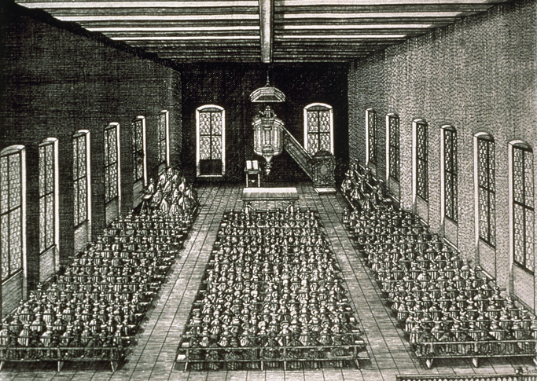
John Calvin Challenges the Church
The Calvinist belief in simplicity is reflected in the design of this Calvinist church in Nuremberg, Germany. No images of saints or religious leaders decorate the church, and the preacher's pulpit is the center of focus.

Slide 12
Quiz: Causes of the Reformation
Christian humanists contributed to the reformation because they
A. supported a powerful Roman Catholic Church that exerted influence in secular matters.
B. suggested that religion should be tailored to meet the needs of the people.
C. urged people to return to the values and practices of the early Christian church.
D. taught that the Bible should be interpreted by well-educated scholars who would then teach others.

Slide 13
Quiz: Martin Luther's Protests Bring Change
The Protestant Reformation swept through Northern Europe when Martin Luther, angered over the abuses within the Church, called for
A. the pope to establish a committee to end the abuses of the Catholic Church.
B. a rejection of the pope's authority, an end to church practices such as indulgences, and that ordinary people be able to read and study the Bible.
C. the peasants to revolt against the church and government, and that all Christians have equal and direct access to God.
D. the pope to ensure that all Christians have equal and direct access to God and that the clergy be allowed to marry.

Slide 14
Quiz: John Calvin Challenges the Church
Visiting Protestants saw John Calvin's theocracy in Geneva as a model community. They brought back his Calvinist ideas, which
A. inspired many Lutherans in Germany to incorporate his ideas and unite against the Catholic Church.
B. were fiercely rejected by French Lutherans, who waged a bloody war with French Calvinists.
C. gained a widespread and peaceful acceptance, particularly in Germany, France, and Scotland.
D. gained many followers, which sometimes resulted in bloody conflicts in places such as Germany and France.

